Slide 1

Hotel aggregator Project
Mentorness Data analyst Internship
By : Bilal BOUDJEMA

Slide 2

Problem Statement
This project focuses on analyzing a dataset of hotel aggregator listings using Power BI.
The dataset encompasses diverse attributes concerning listings, hosts, reviews, and availability.
The goal is to develop comprehensive visualizations and insights revealing trends, patterns, and factors affecting listing performance.

Slide 3
Objectives
Utilize Power BI to explore key metrics including pricing, availability, host characteristics, and review scores.
Derive actionable insights to enhance the quality and competitiveness of listings.
Identify trends and patterns within the dataset to inform strategic decision-making for stakeholders.

Slide 4
Expected Impact
Enhanced understanding of factors influencing listing performance.
Improved decision-making for optimizing listing quality and competitiveness.
Empowered stakeholders with actionable insights to drive strategic initiatives.

Slide 5
Approach
Data Exploration: Understand the structure and contents of the dataset, identifying relevant variables and potential insights.
Visualization Development: Create intuitive visualizations using Power BI to represent various aspects of the dataset, facilitating easy interpretation and analysis.
Insight Generation: Analyze visualizations to uncover trends, correlations, and outliers, providing valuable insights for stakeholders.
Actionable Recommendations: Translate insights into actionable recommendations aimed at improving listing quality and competitiveness.

Slide 6
Dataset Description
1. id: Unique identifier for each listing.
2. listing_url: URL of the listing on the hotel aggregator platform.
3. scrape_id: Identifier for the data scraping event.
4. last_scraped: Date of the last data scrape.
5. source: Source of the listing information.
6. name: Name of the listing.
7. description: Description of the listing.
8. neighborhood_overview: Overview of the neighborhood where the listing is located.
9. picture_url: URL of the listing's picture.
10. host_id: Unique identifier for the host.
11. ... (and many more columns capturing details about hosts, location, property type, room details,
amenities, pricing, availability, reviews, and other relevant information)

Slide 7
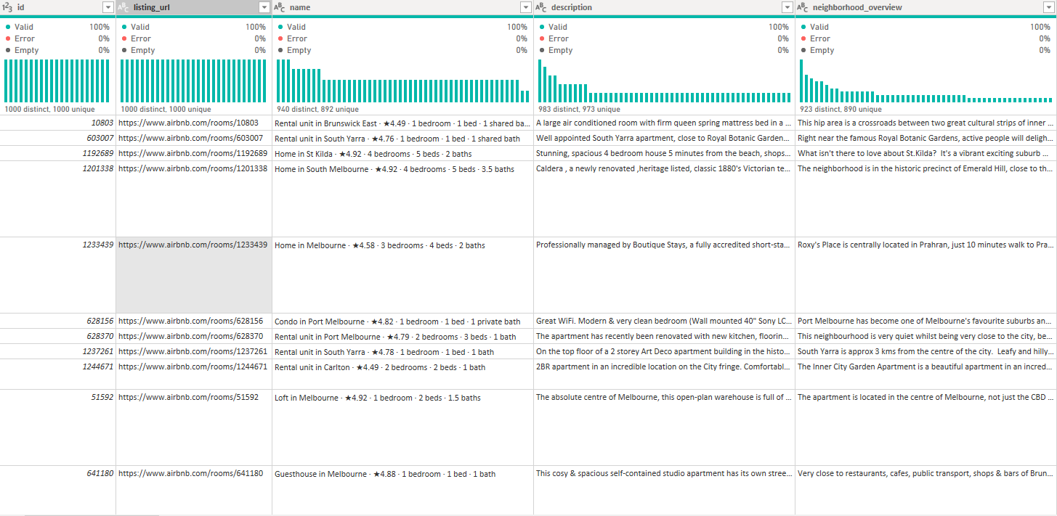
Sample DataSet

Slide 8
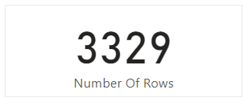
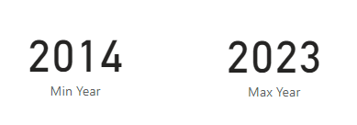
Data Exploration
There are 64 Columns
3329 of Rows
Maximum Year is 2023
Minium Year is 2014

Slide 9
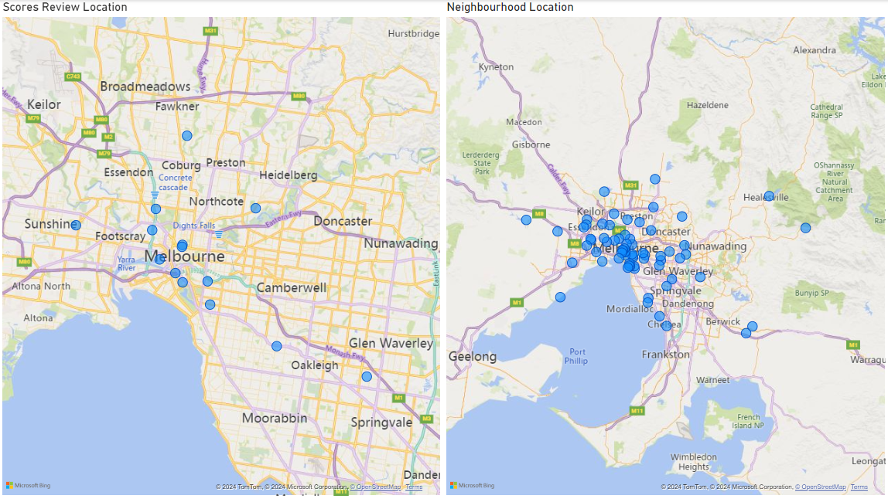
Geographical Insights
Most of neighbourhood are based on the center of melbourne
There are few score reviews in the center of melbourne

Slide 10
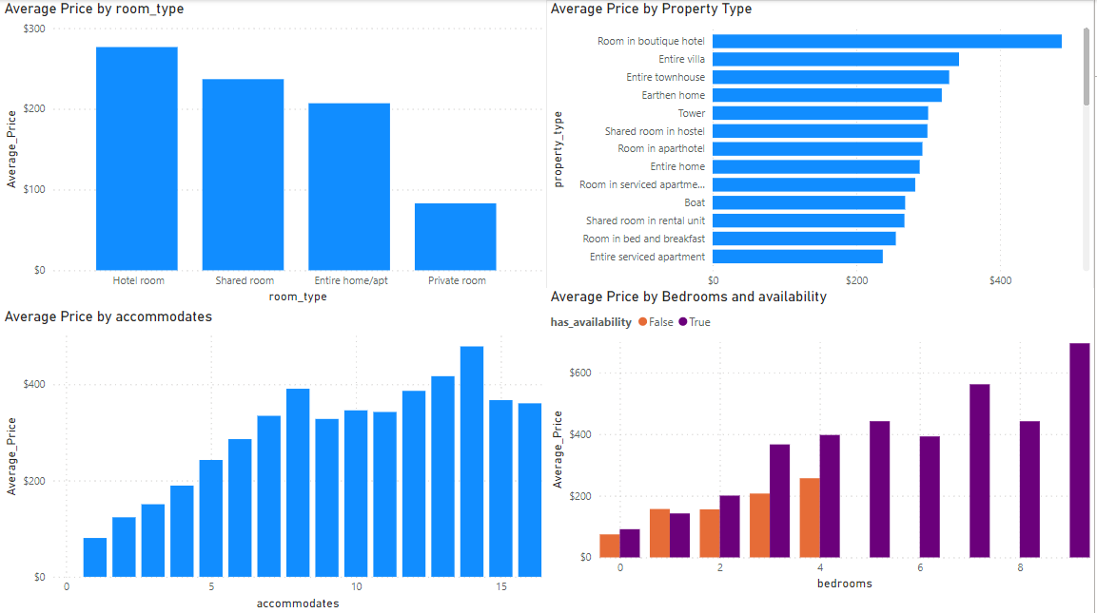
Pricing and Availability Analysis
Hotel rooms come with a hefty price tag, especially those in boutique hotels.
Properties with fewer bedrooms are typically scarce and come at a premium compared to larger properties in prime locations.

Slide 11
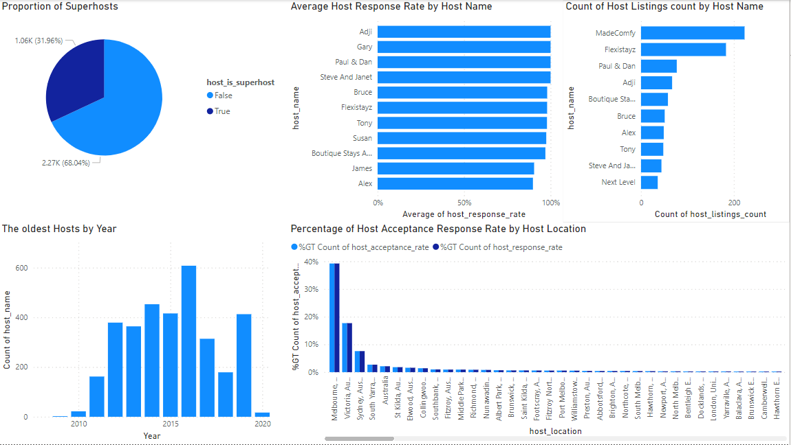
Host Performance
31% of hosts hold the title of Superhost.
Adji and Gary rank at the top for their response rates.
2016 marks the peak year for host registrations.
Melbourne takes the lead as the top location based on acceptance/response rates.

Slide 12
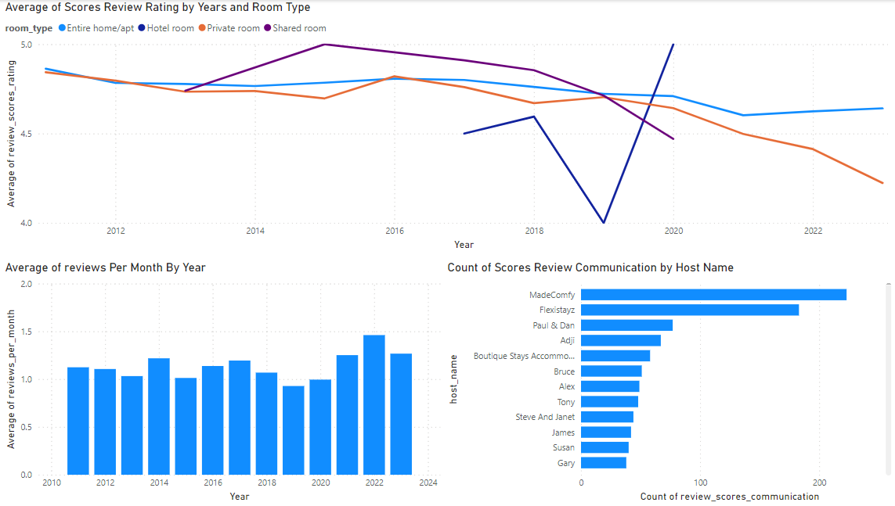
Review Scores and Guest Satisfaction
The average score for hotel rooms remains consistently high over the years.
MadeComfy and Flexitayz both boast over 100 reviews with perfect scores.

Slide 13
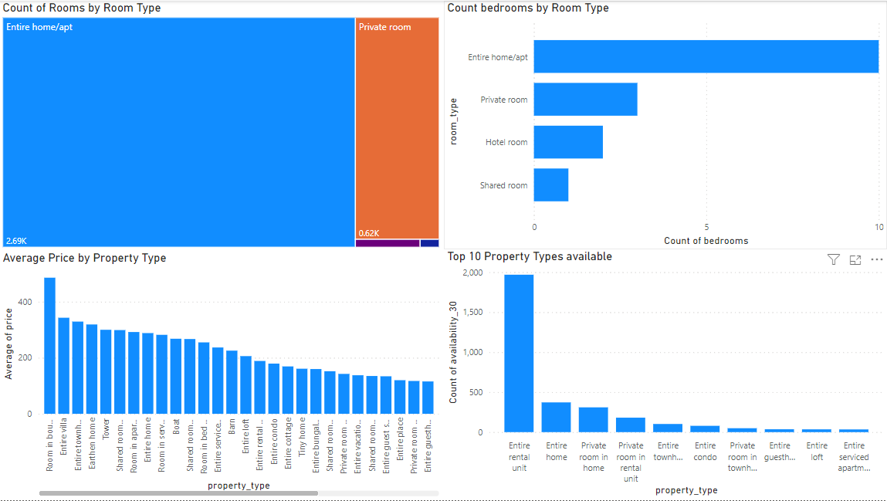
Property Type and Room Analysis
Over 2.5 thousand rooms are classified as "Entire home/apt."
Within the "Entire home/apt" category, there is a higher prevalence of "bedroom" listings compared to "private room" listings.
Despite being consistently available, "Entire rental units" remain expensive, leading customers to prefer other, more affordable and less spacious property options.

Slide 14
Conclusion
This project aims to leverage Power BI to analyze hotel aggregator listings, providing stakeholders with actionable insights to enhance listing quality and competitiveness.
By employing data-driven decision-making, this project endeavors to drive positive outcomes for the organization and its stakeholders.

